Slide 1
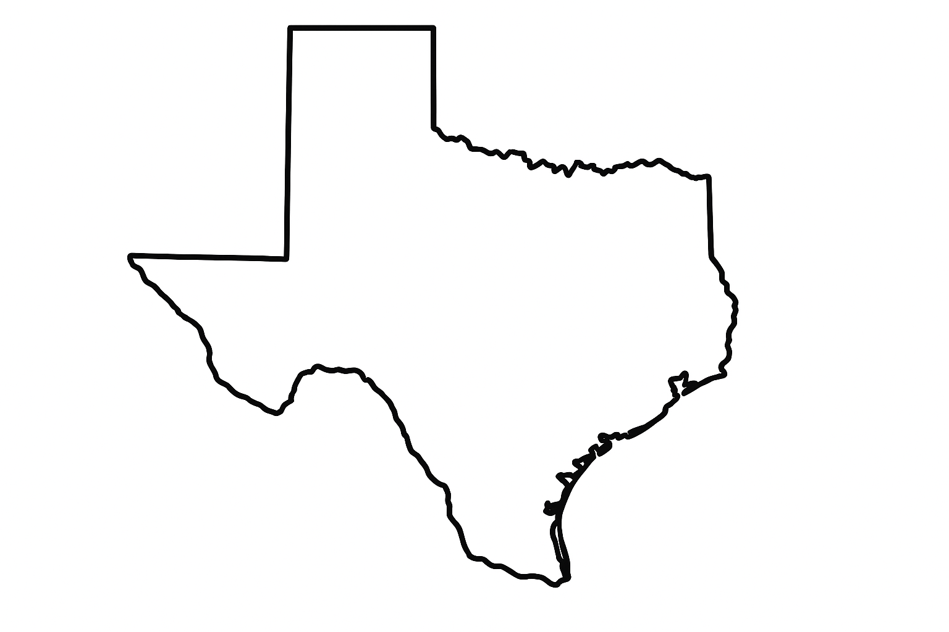
One Texas Sales Kickoff
Pre-Work Assignment
April 1 (Dallas) | April 2 (Houston)

Slide 2
One Texas Vision
One Texas is becoming the trusted partner for all of Texas.
We unite under a bold initiative: One Texas. It’s our commitment to elevate our clients, our people, and our marketplaces by driving Focused Growth in high-impact customers, forging Connected Partnerships across enterprises and ecosystems, achieving meaningful Market Impact that reflects our purpose-led maturity, and building Collective Excellence where every Improver contributes with authenticity and ownership behavior. We do this grounded in our culture of trust, so we grow not just bigger, but better, together.
Focused Growth
Connected Partnerships
Market Impact
Collective Excellence
Notes:
Focused Growth is Strategic Pursuit and Sales Acceleration
Connected Partnerships is deeper participation in ecosystem and more co-sell
Market Impact is speaking, podcast, and Executive Elevation
Collective Excellence is Improver Growth and Repeatability

Slide 3
Your Account Growth
Choose your account!
The account plans have been very good when utilized properly. We are going to work doing more of that together.
Format: 5 minutes to present, followed by 15 minutes of group brainstorming.
Items to cover your account plan:
Business Priorities - What are their priorities? What do they need?
Relationships - Who do we know? What's our relationship strength?
The Opportunity - Where's the opportunity for Improving? What are you pitching?
Global Delivery - Would this account benefit from a blended team?

Slide 4
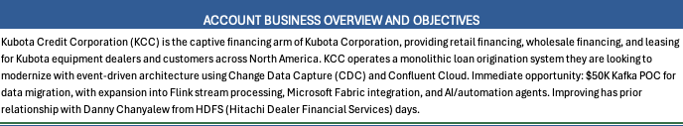
Business Priorities (Example)
Kubota Credit
Industry: Machinery Manufacturing | HQ: Dallas, TX
Budget cycle: Q1 budget begins in July.

Slide 5
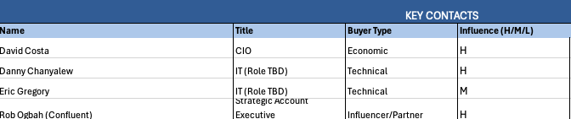
Relationships (Example)
Gap:
No relationship with VP of Supply Chain (key stakeholder for ERP project).

Slide 6
The Opportunity (Example)
Current Engagement
Azure Migration (Data architect & Data engineers) - $1.2M annual run rate
What We're Pitching
Azure migration services (Phase 1: assessment + roadmap)
DevOps transformation consulting alongside migration
Potential Growth
$1.2M current > $3.5M within 18 months if Azure migration and AI/ML land.
Ask for the Room of Improvers
Need help connecting with VP Supply Chain. Who in this room has manufacturing contacts that could open doors?

Slide 7
Global Delivery (Example)
Assessment
Yes - strong fit for the Azure migration workstream.
Why It Fits
Can leverage LATAM for the strong Azure Data experience (Cinemark)
Cost sensitivity on migration execution (not strategy)
Considerations
AI/ML workstream should stay onshore

